Slide 1
Testing Mechanisms for Open-ended Evolution in Reversible CA
Angelica Berner

Slide 2
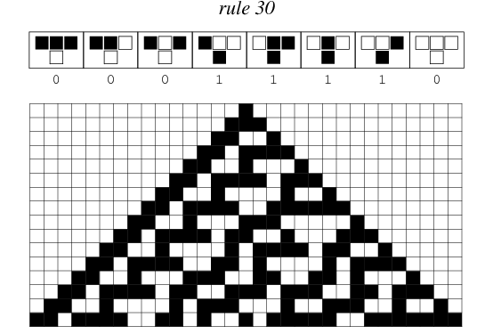
What does any of that mean?
Computational model that evolves over time
Cellular Automata can be reversible
CA have potential to demonstrate OEE
http://mathworld.wolfram.com/images/eps-gif/ElementaryCARule030_700.gif
Notes:
Model is given an initial condition and a rule to follow, which determines the output of the next time step. Reversible CA are CA that can be run backwards and still be a cellular automata. OEE can simply be defined as an “on-going production of complexity” and can be said to be one of the defining features of life.

Slide 3
Important Note
000
111
001
110
101
010
Notes:
Important note: A CA that is stuck in a cycle of all 1s or all 0s will continuously be in a state of all 1s or all 0s. If it is any other state, it can never become all 1s or all 0s.

Slide 4
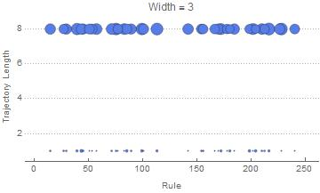
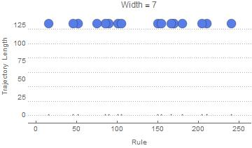
Control Case
Notes:
Our original question: Which rule gives us the longest state trajectory when JUST looking at reversible rules? Our control case selected a random rule to start with and updated itself as it progressed to 2^w. These two graphs, one of width 3 and the other of width 7, demonstrate our overall findings for all widths 3 through 7. We found that our trajectory was actually dependent on the INITIAL CONDITION, and NOT THE RULE. Information is preserved in the initial condition, where it will never reach a dead space (either it will be complex or it will be all 1s or all 0s).

Slide 5
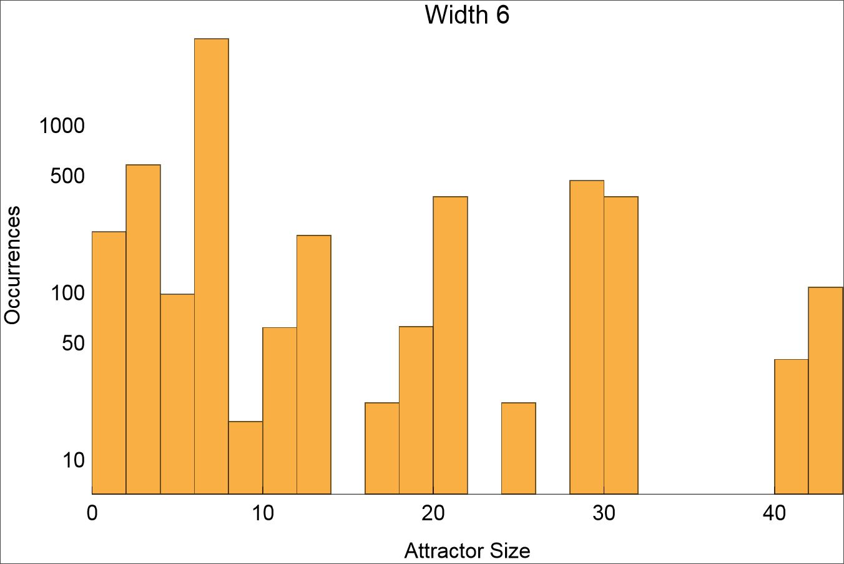
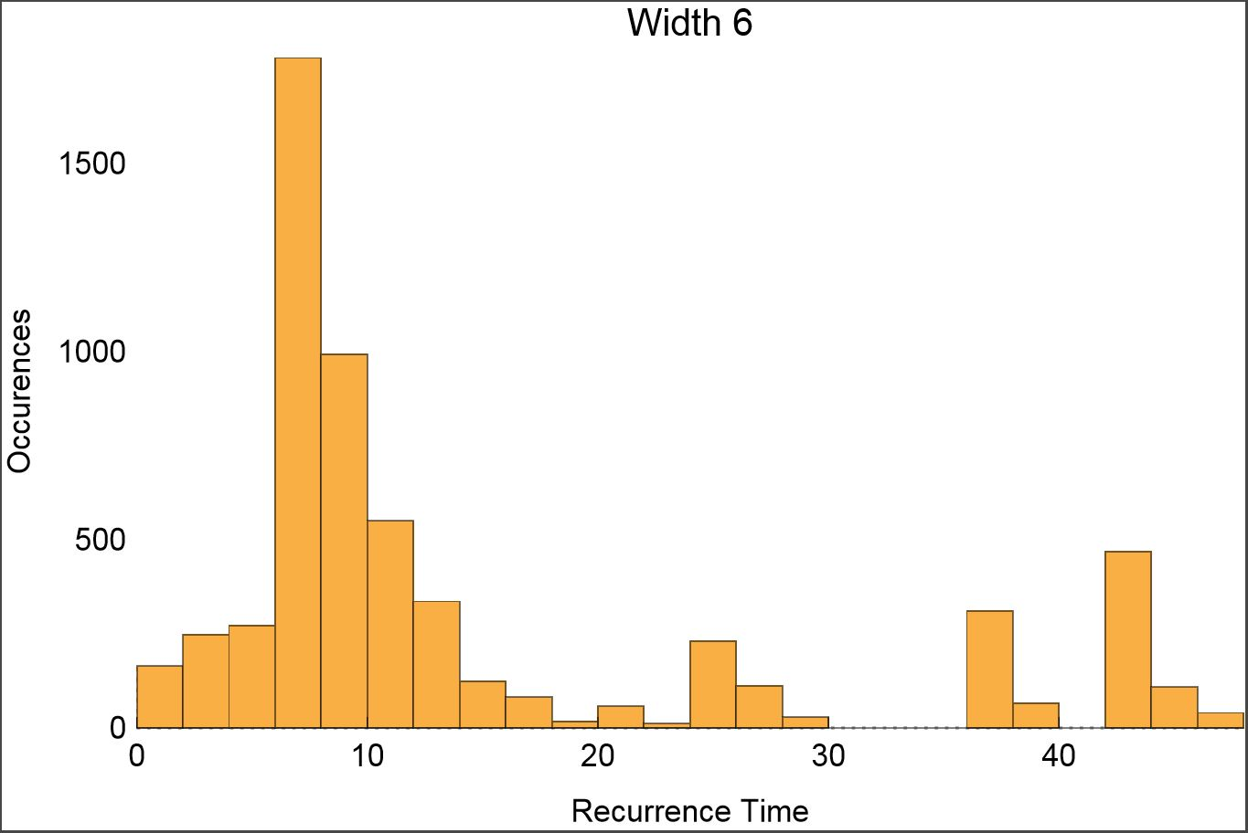
Current Data: Width 6

Slide 6
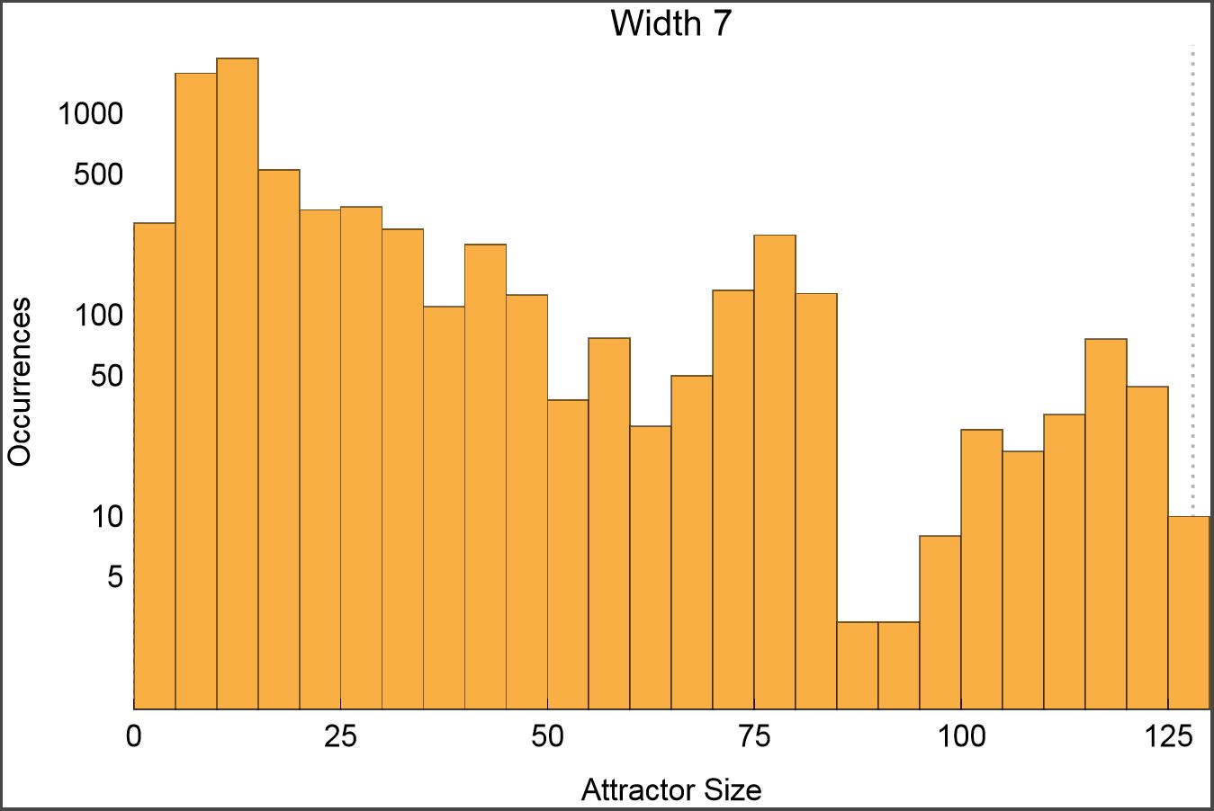
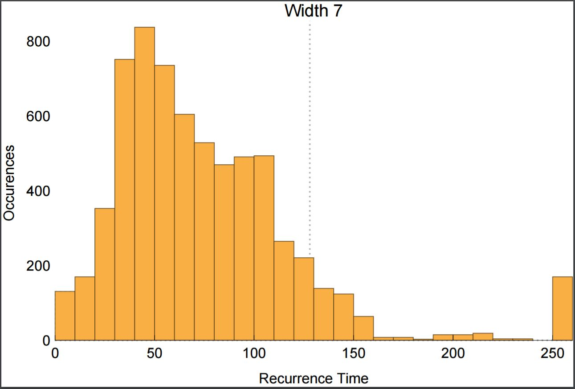
Current Data: Width 7

Slide 7
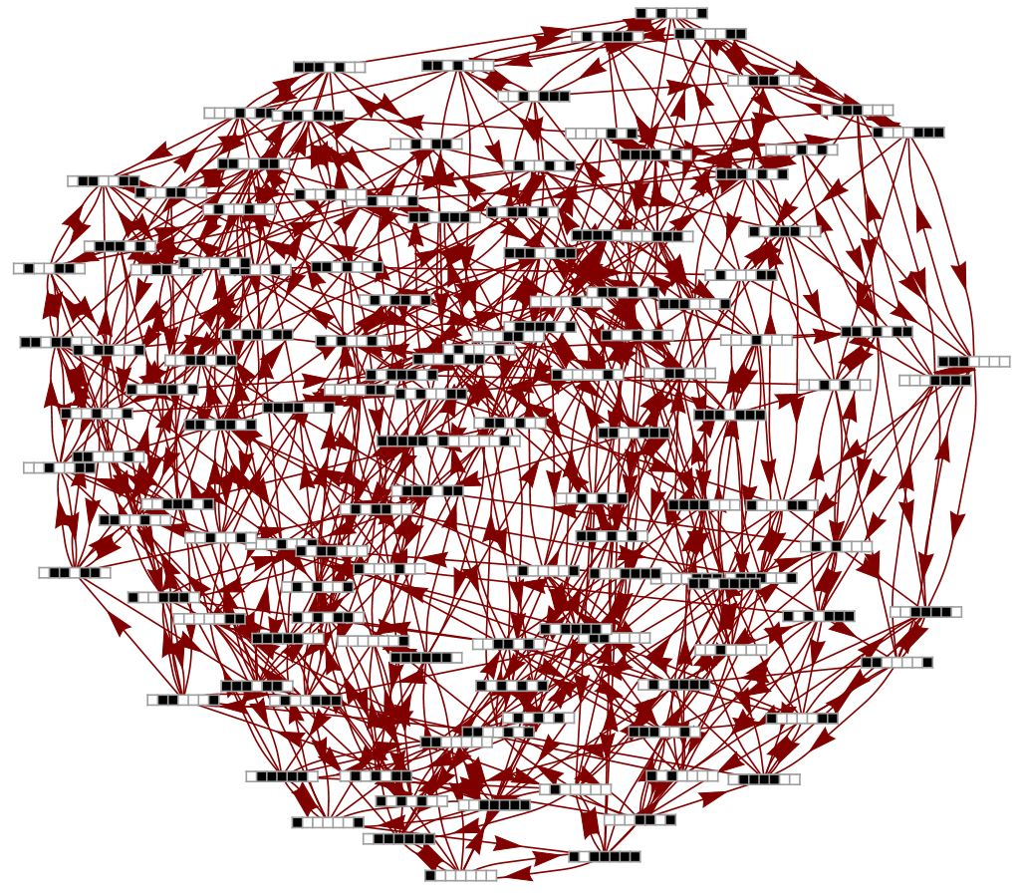
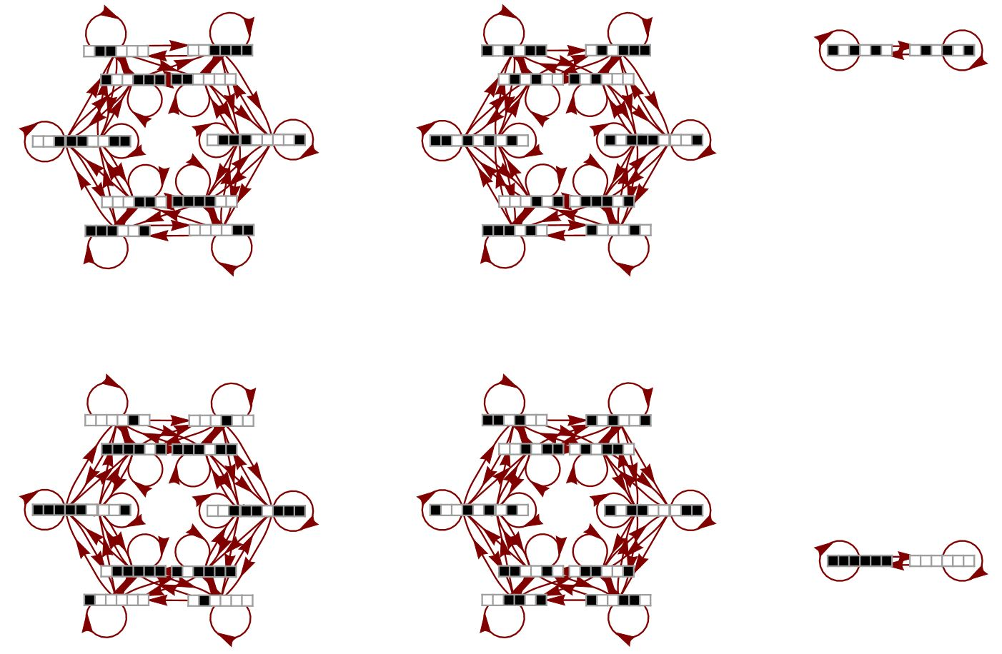
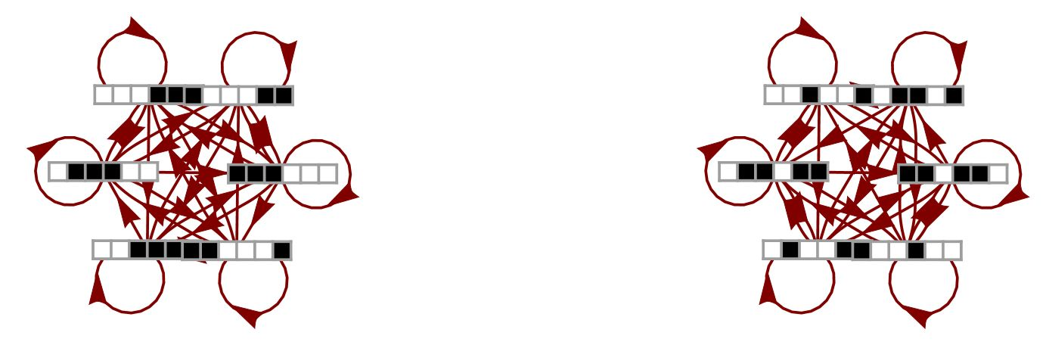
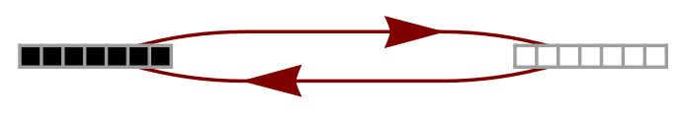
State Transition Diagrams

Slide 8
Conclusion and next steps
Reversible rules capable of producing OEE under certain conditions
How many reversible rules are necessary for OEE?

Slide 9
Acknowledgements
I would like to express my sincerest gratitude to my mentor Sara Walker, graduate student Alyssa Adams, NASA Space Grant, and the School of Earth and Space Exploration at Arizona State University.

